Slide 1

1000 BUSINESSES IN 100 DAYS
A Presidential Youth Employment Intervention

Slide 2
SOUTH AFRICA YOUTH ENTREPRENEURSHIP CONVERSATION

Slide 3
YOUTH ENTRPRENEURSHIP: KEY DATA
Youth participation in entrepreneurship is relatively small. South African total entrepreneurial activity (TEA) in the 25 to 34 year age cohort was 9.2%, which was less than half the Africa average as well as considerably lower than the average for efficiency driven economies (18%). There is a correlation between education level and the level of TEA – with 67,4% TEA rate for those who have completed secondary education and beyond while the level of TEA for those without education is at 4,4%. Young men are more likely to be entrepreneurs than young women and youth in the age group 25-34 years

Slide 4
YOUTH ENTRPRENEURSHIP: KEY DATA
In two townships the study was conducted in, only 15 percent of micro-enterprises were run by young people under 30. Of this, one in three of the young entrepreneurs were non-South Africans. In Delft, Cape Town, four out of 10 hair salons and barbers were owned by young people, and seven in 10 of these were owned by foreign entrepreneurs
The lifestyle and leisure sectors contain some of the most promising youth start-ups, which found that the young entrepreneurs are those that run internet cafés or produce music at home and DJ, or design flyers and posters, or operate gyms, design and make clothes or run takeaways that sell fast food to late-night revellers. The study found that South Africans are majority owners of these kinds of businesses.

Slide 5
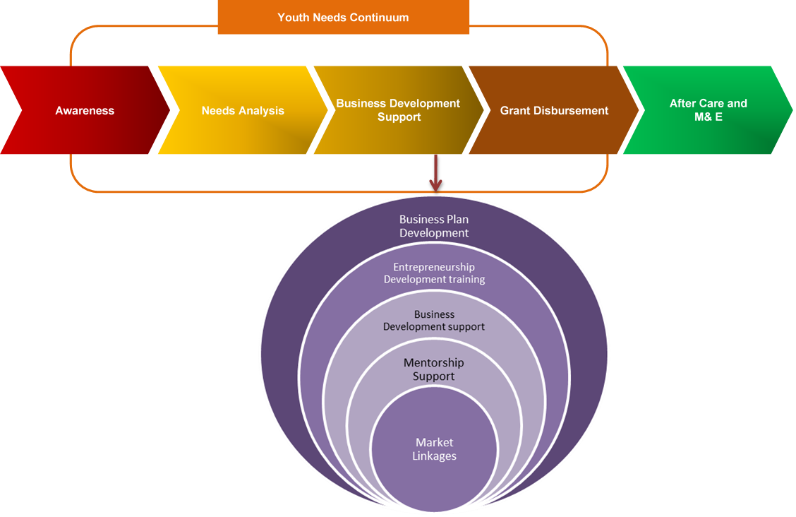
NYDA YOUTH ENTRPRENEURSHIP VALUE CHAIN

Slide 6


Slide 7
WHAT WAS THE 1000 BUSINESSES IN 100 DAYS
Providing financial support to micro enterprises particularly in townships and rural areas.
Providing government services in an effective and an efficient manner.
Processes which are fair, transparent and equitable in nature.
Allowing young people to capitalize on opportunities in their local economies.
The first steps in the Presidential Youth Employment Intervention, the most comprehensive plan in South Africa’s democratic history to address youth unemployment.
Reaching vulnerable and marginalized young people.

Slide 8
SECTORS SUPPORTED IN 1000 BUSINESSES
Sector | Number | Percentages
Agriculture and agro processing | 138 | 14%
Arts, Education, Health | 18 | 2%
Automotive and Manufacturing | 142 | 14%
Construction and property | 34 | 3%
Consulting and Legal | 10 | 1%
Hospitality | 44 | 4%
Information, Communication and Technology | 37 | 4%
Installation, Maintenance and Repair | 20 | 2%
Logistics, tourism and recycling and waste | 12 | 1%
Services | 430 | 43%
Textiles and indigenous goods | 10 | 1%
Wholesale and retail | 105 | 11%
Total | 1 000 | 100%

Slide 9
GENDER BALANCE IN 1000 BUSINESSES
Gender | Amount | Percentages
Male | 578 | 58%
Female | 422 | 42%
Total | 1 000 | 100%

Slide 10
PROVINCIAL DATA IN 1000 BUSINESSES
Province | Number | Amount | Percentages
Eastern Cape | 149 | R6 220 293 | 15%
Free State | 113 | R4 533 574 | 11%
Gauteng | 231 | R10 127 518 | 24%
KZN | 152 | R5 885 843 | 14%
Limpopo | 115 | R5 156 041 | 12%
Mpumalanga | 152 | R7 258 907 | 17%
North West | 27 | R943 665 | 2%
Northern Cape | 24 | R1 017 514 | 2%
Western Cape | 37 | R1 545 077 | 4%
Total | 1 000 | R42 688 432 | 100%

Slide 11
IMPACT OF COVID-19

Slide 12
IMPACT OF COVID - 19
Line item | Amount
Original number of days forecast for project (14 – February – 16th June) | 123 days
Days lost (26 March – 31 May) | (66 days)
Days added – (1 June – 12 August) | 73 days
Net days (excluding lockdown) to complete project compared to original forecast | 130 days

Slide 13
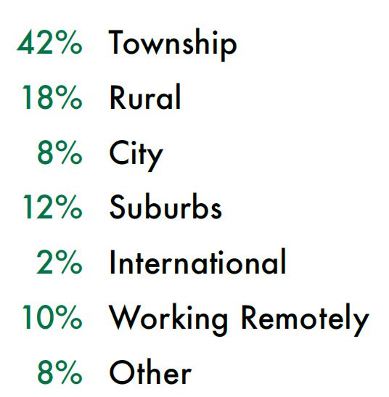
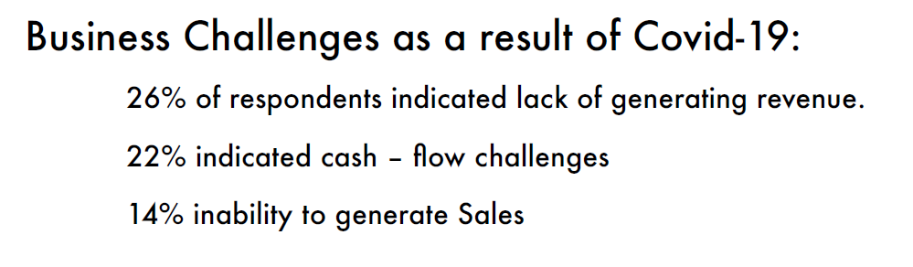
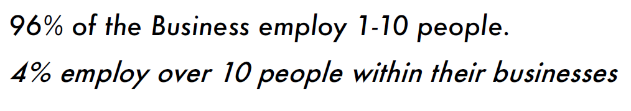
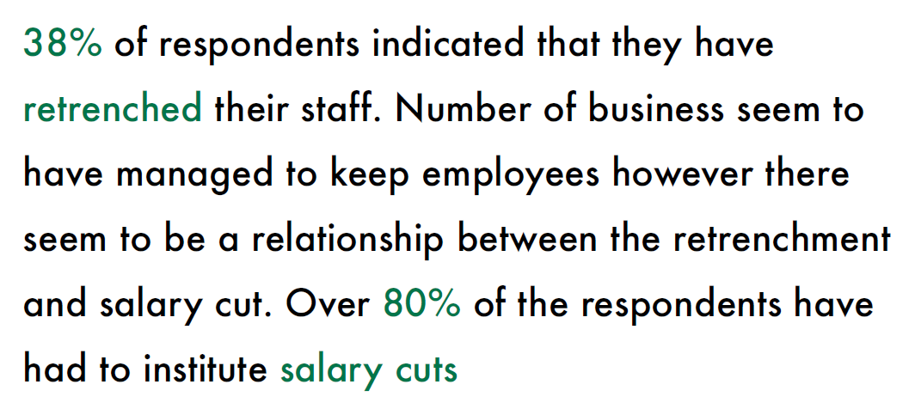
IMPACT OF COVID - 19

Slide 14
LOOKING FORWARD

Slide 15

YOUTH EMPLOYMENT INTERVENTION

